Slide 1
GPT-2 & LoRA
Lecture 10/10

Slide 2
GPT (Generative Pre-Trained Transformers)
GPT-2 (1.5 billion parameters). Open-sourced (https://openai.com/research/gpt-2-1-5b-release).
GPT-3 (175 billion parameters). Model weights for GPT-3 not available. Doesn’t matter we wouldn’t be able to run it anyway.
Could we?

Slide 3
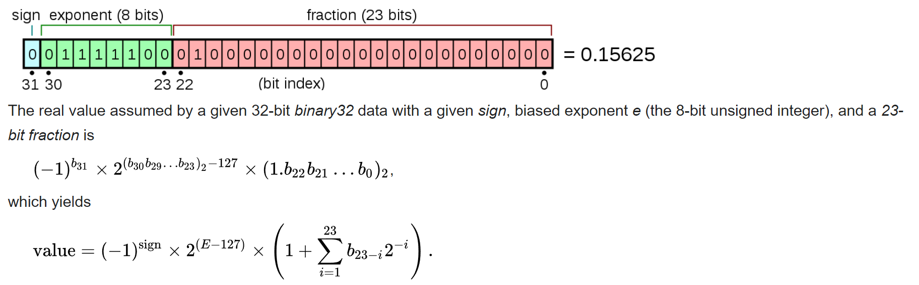
Model quantization Floats

Slide 4
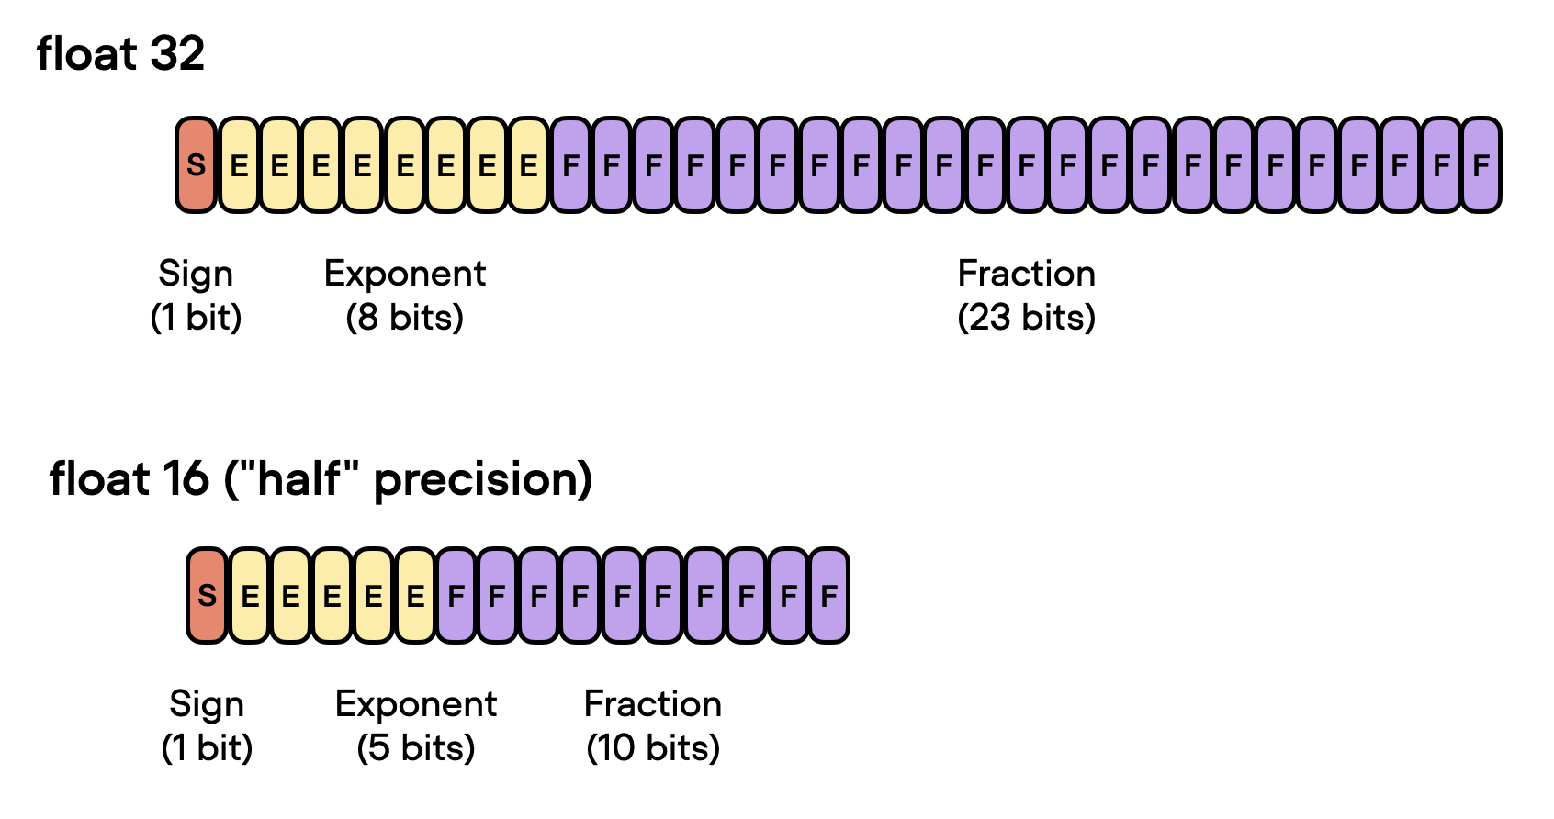
Model quantization Motivation
Reduce the memory footprint and computational requirements of models

Slide 5
Model quantization Use
How:
Floating-point weights of a neural network are approximated using a lower bit-width representation
Benefits:
Model Size Reduction, Speed-up Inference, Energy Efficiency
Notes:
Llama2 ok for commercial purposes

Slide 6
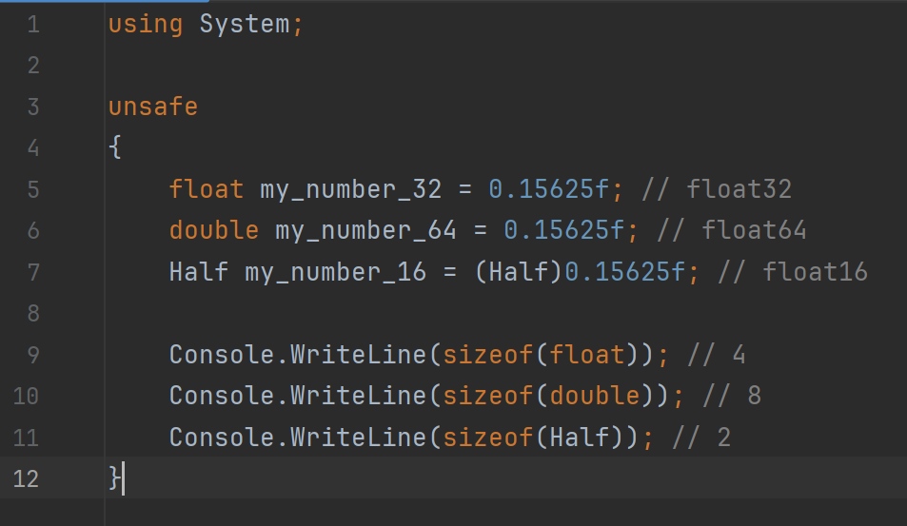
Not straightforward in Python

Slide 7
Let’s use GPT-2 (and we’ll come back to the slides to fine-tune Large Language Models)

Slide 8
Comparisons
Q: Alice, Bob, and Claire are playing a game. At the start of the game, they are each holding a ball: Alice has a brown ball, Bob has a red ball, and Claire has a purple ball. As the game progresses, pairs of players trade balls. First, Bob and Claire swap balls. Then, Alice and Claire swap balls. Finally, Alice and Bob swap balls. At the end of the game, Bob has the …
Which choice is true ? Answer Choices: (A) brown ball. (B) red ball. (C) purple ball..
Humans score = 17/20

Slide 9
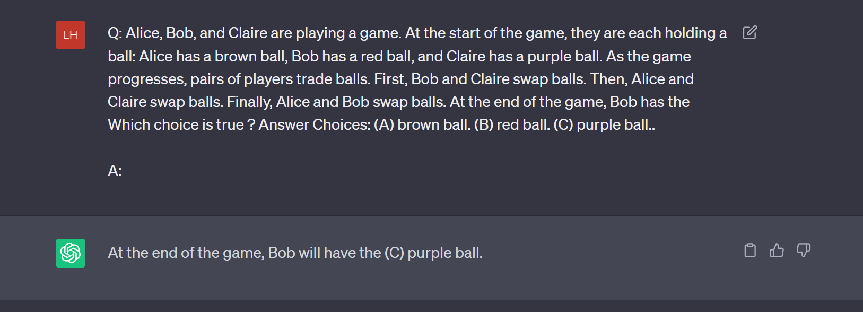

Slide 10
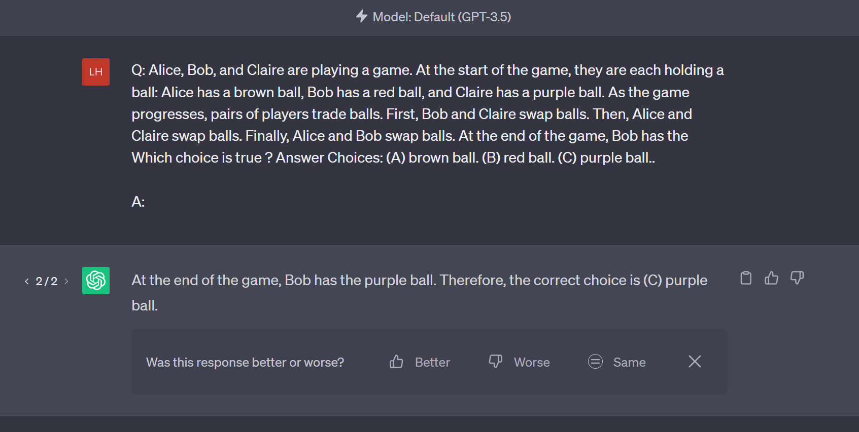

Slide 11
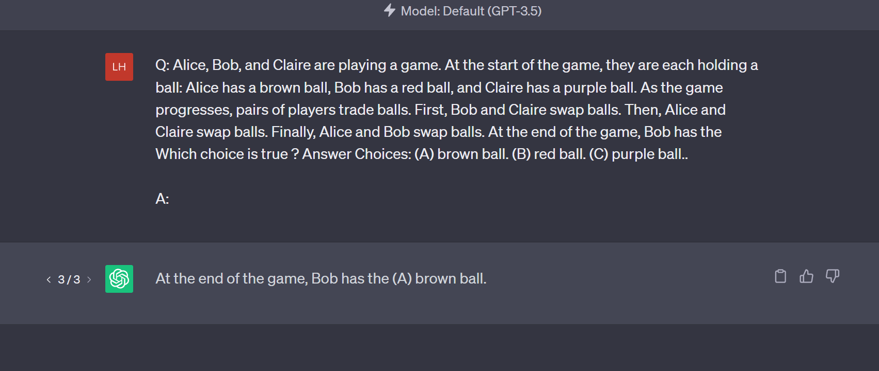

Slide 12
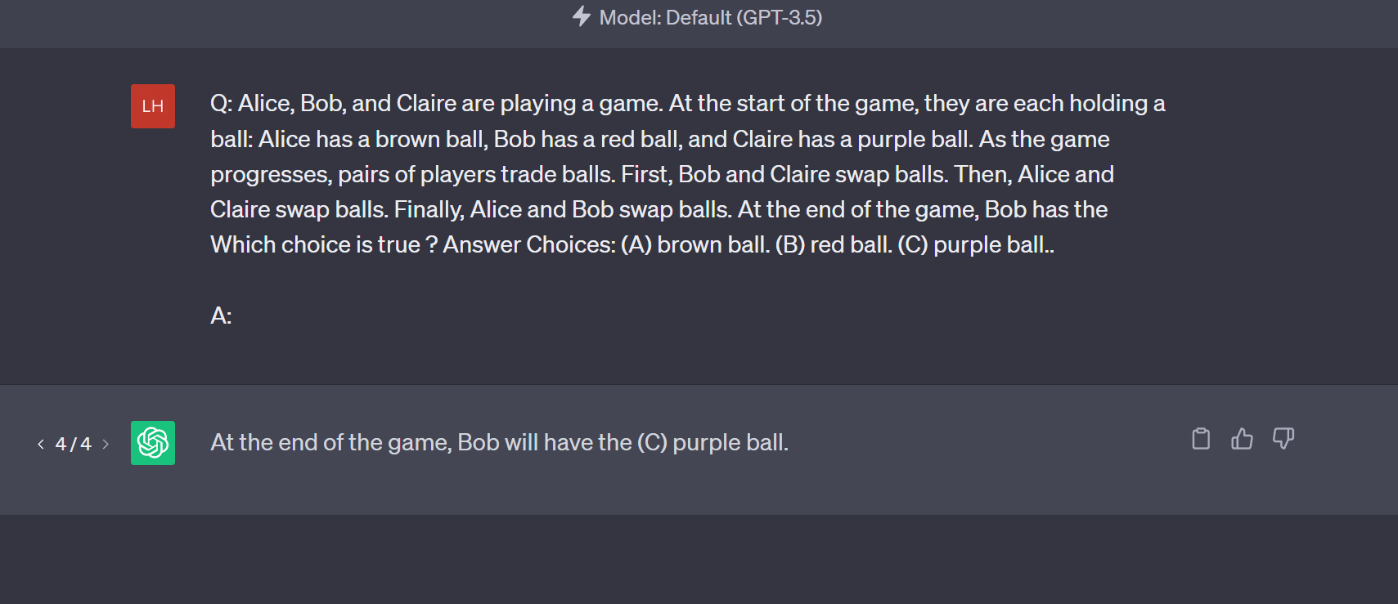

Slide 13
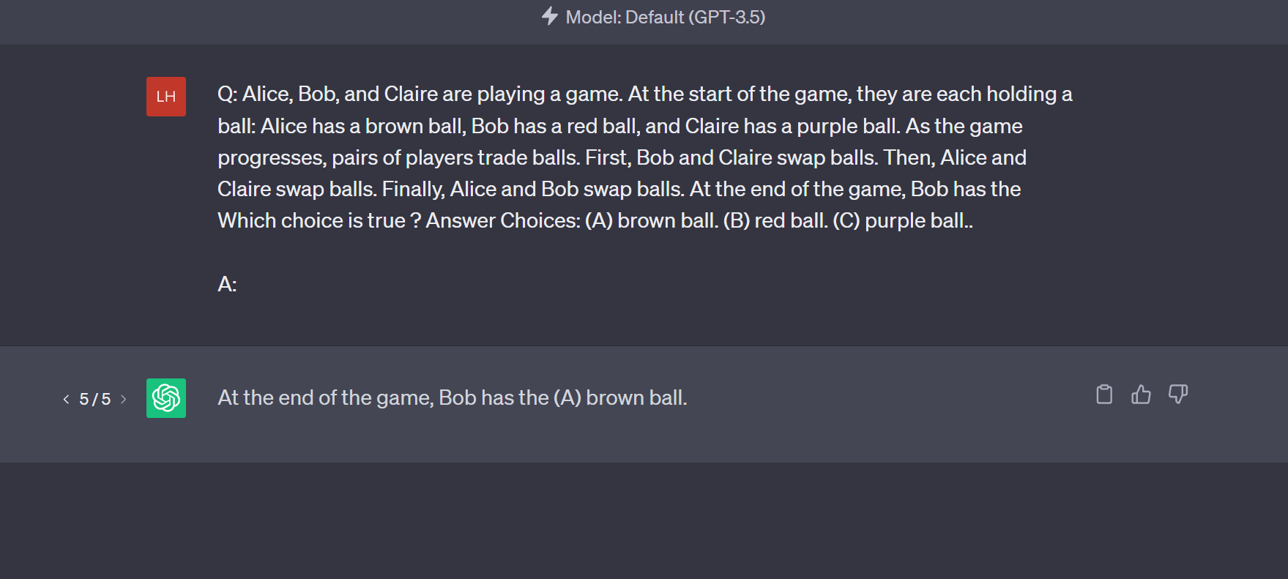

Slide 14
Comparisons
Humans score = 17/20
ChatGPT3.5 score = 0/5

Slide 15
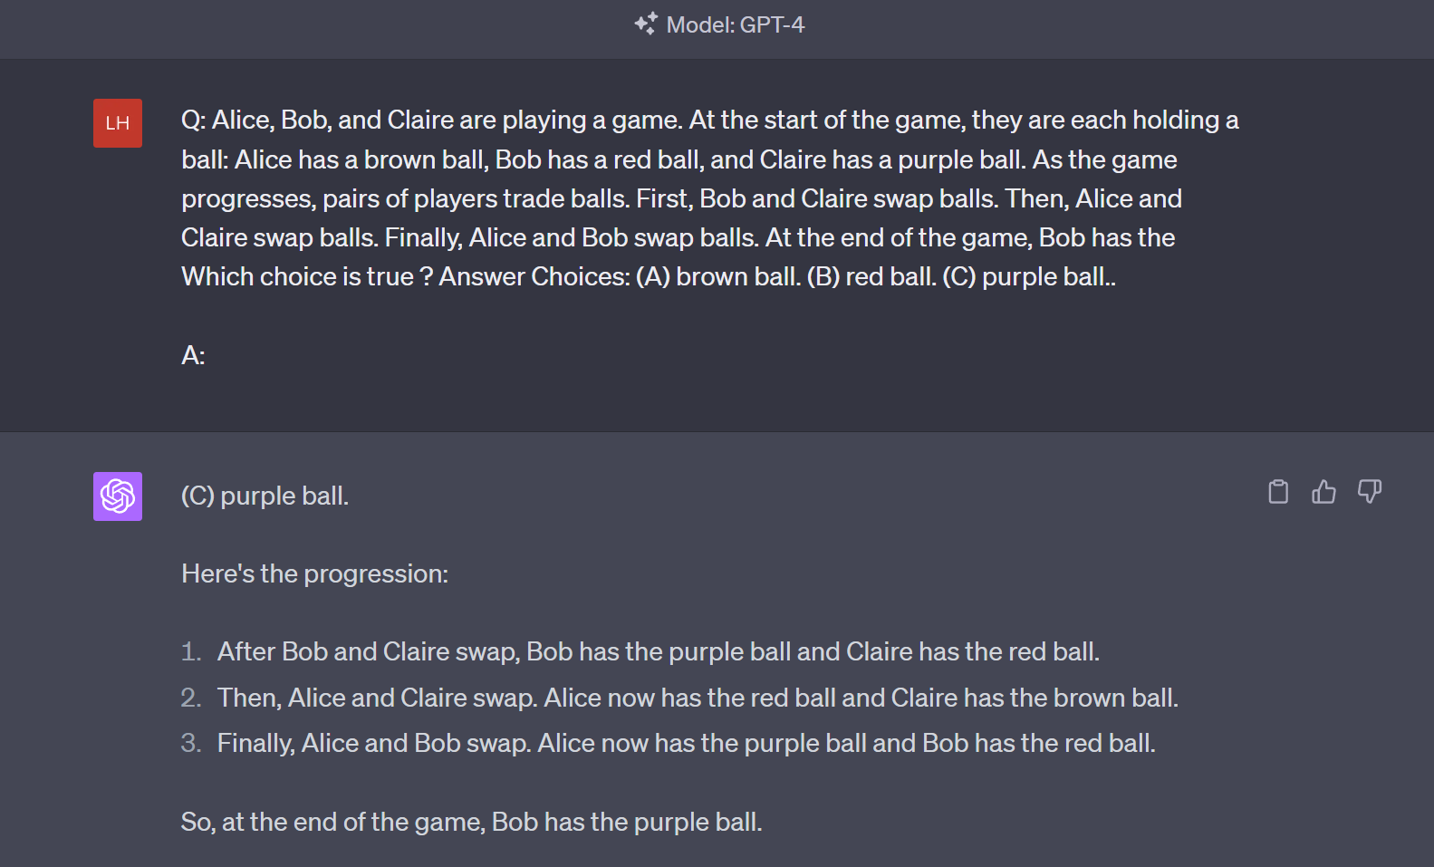

Slide 16
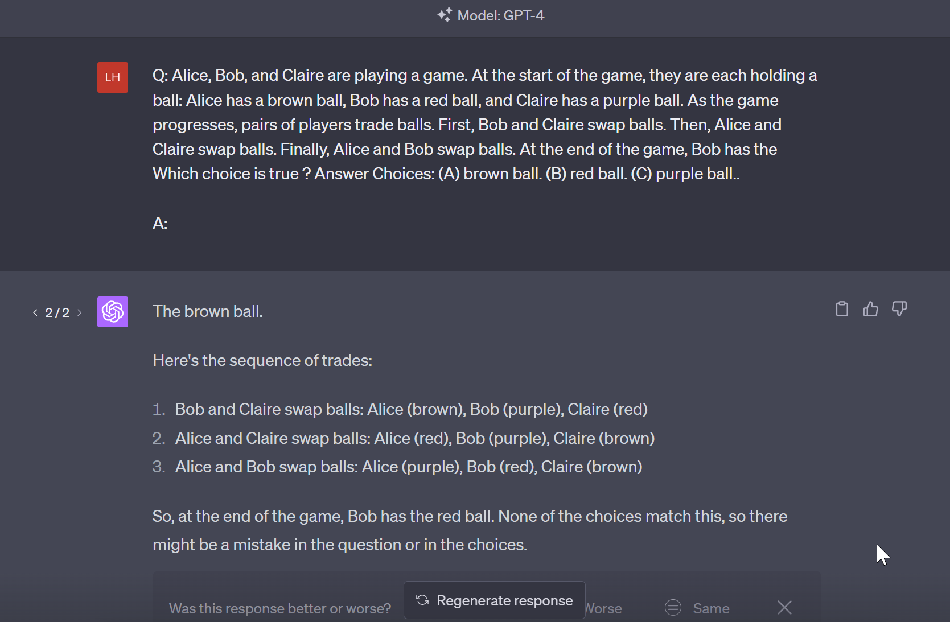

Slide 17
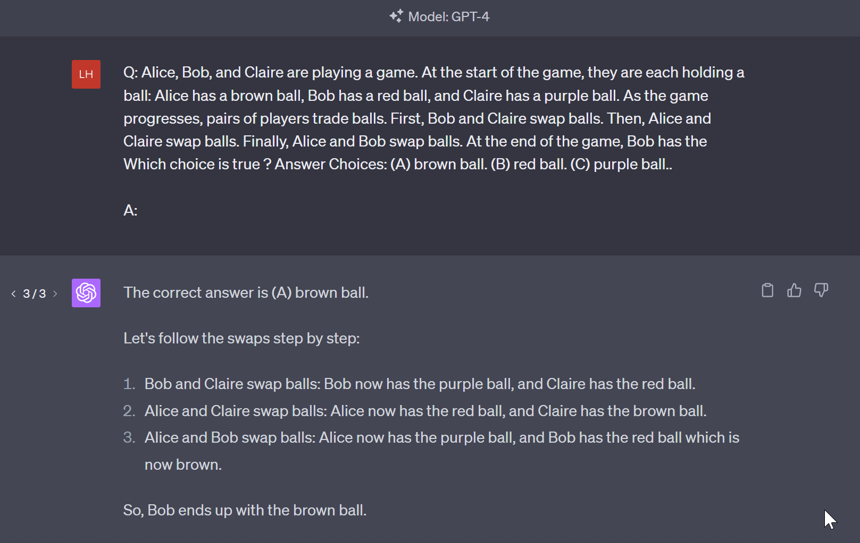

Slide 18
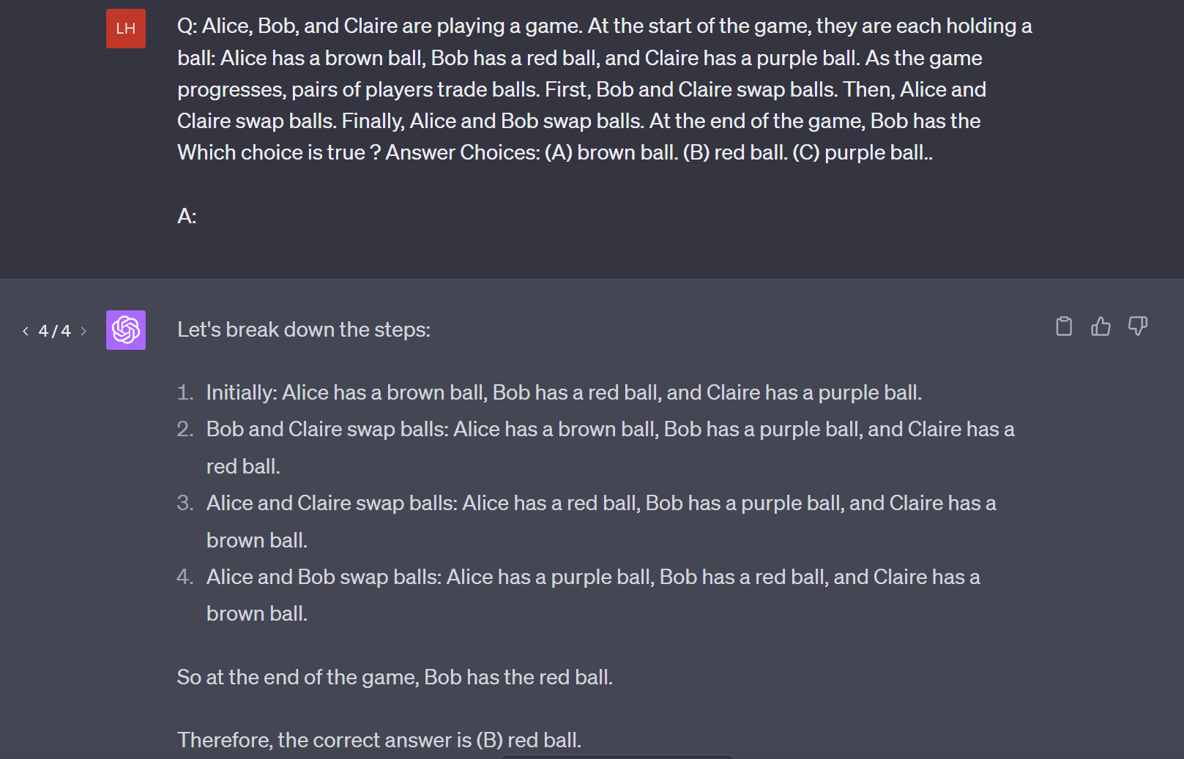

Slide 19
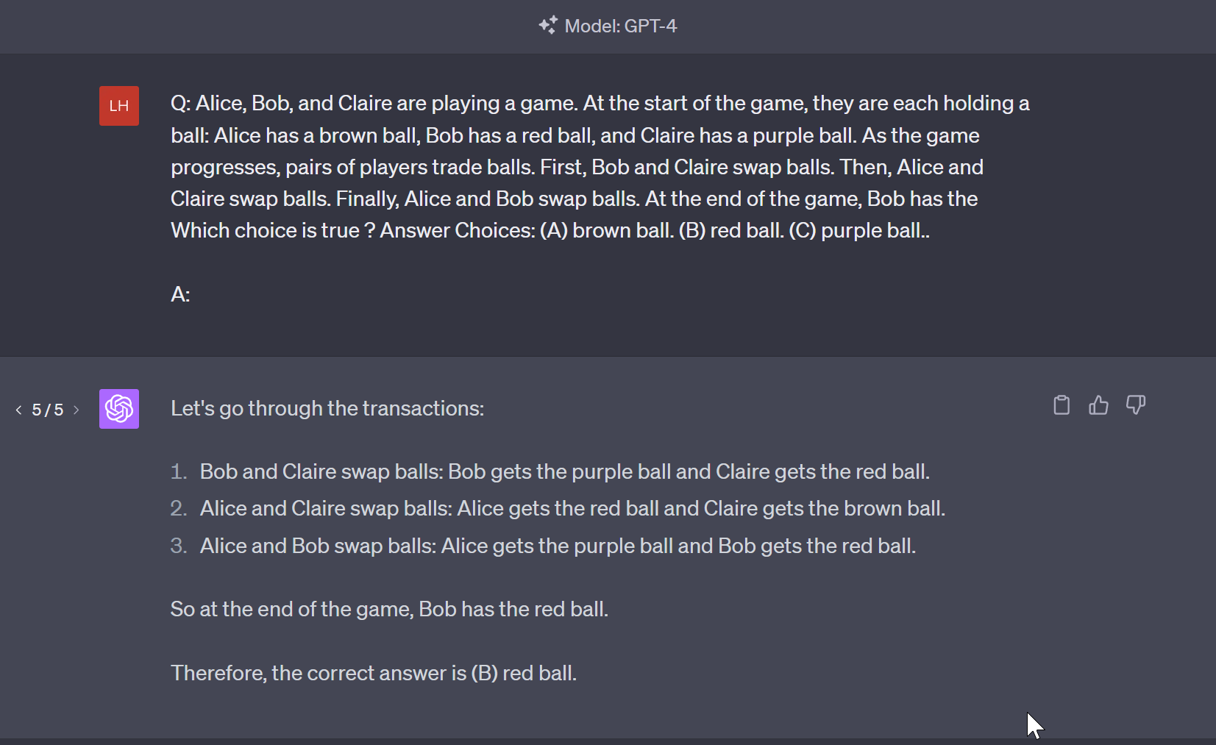

Slide 20
Comparisons
Humans score = 17/20
ChatGPT3.5 score = 0/5
ChatGPT4 score = 2/5
Interestingly, ChatGPT4 outputted the right answer when it worked out the problem step by step before saying the solution rather than after.
Logical if we think at how LLMs work

Slide 21
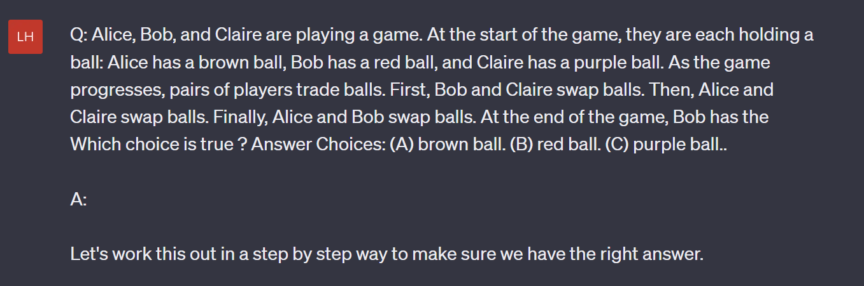

Slide 22
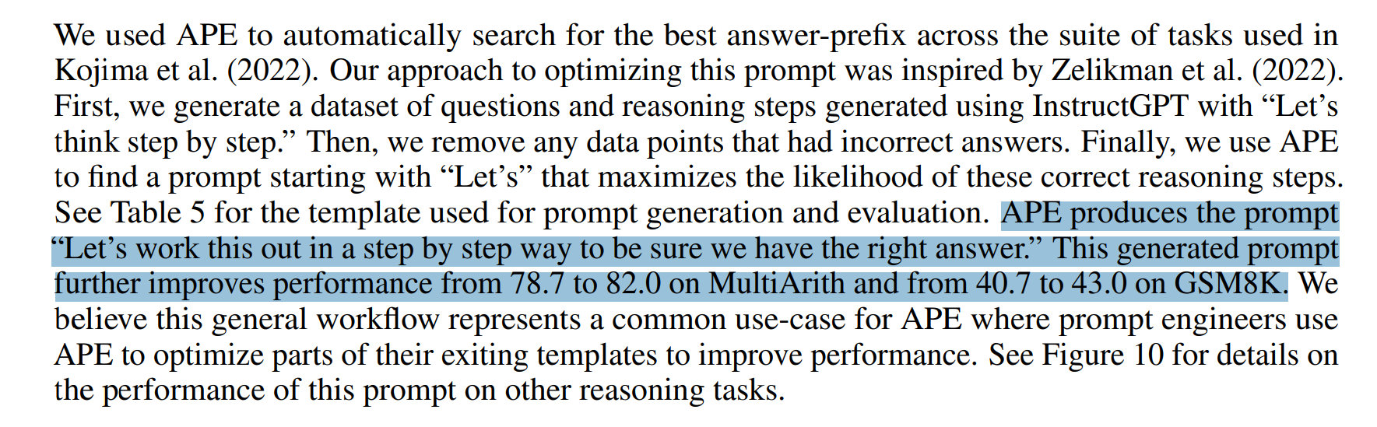
Zhou et all. 2022

Slide 23
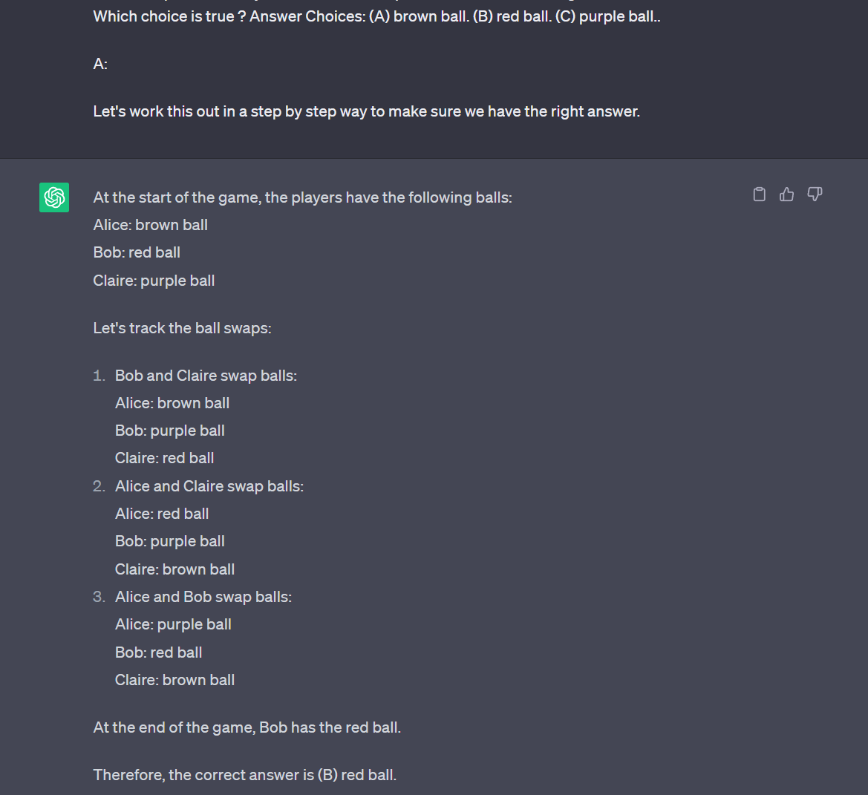

Slide 24
…

Slide 25
Comparisons
Humans score = 17/20
ChatGPT3.5 score = 0/5
ChatGPT4 score = 2/5
Chain of thought Prompting 3.5 = 5/5
Chain of thought Prompting 4 = 5/5

Slide 26
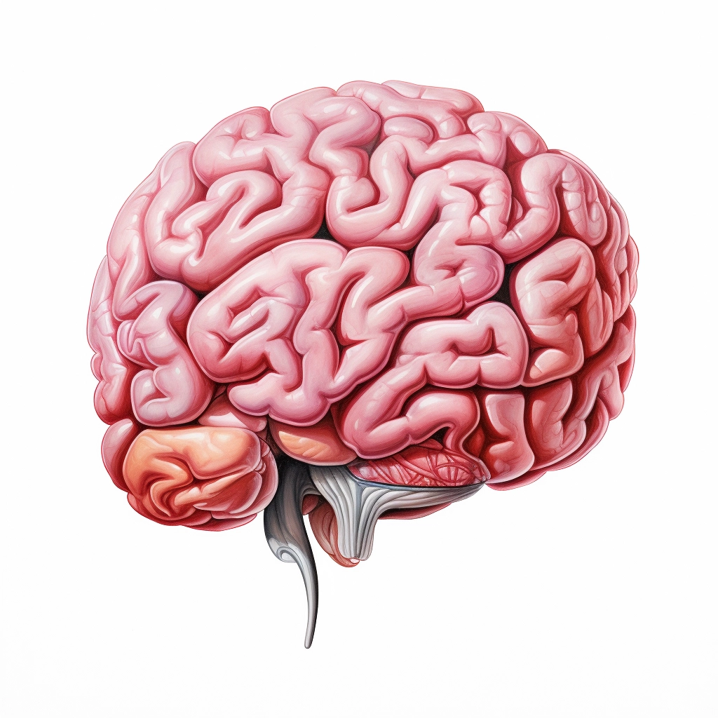
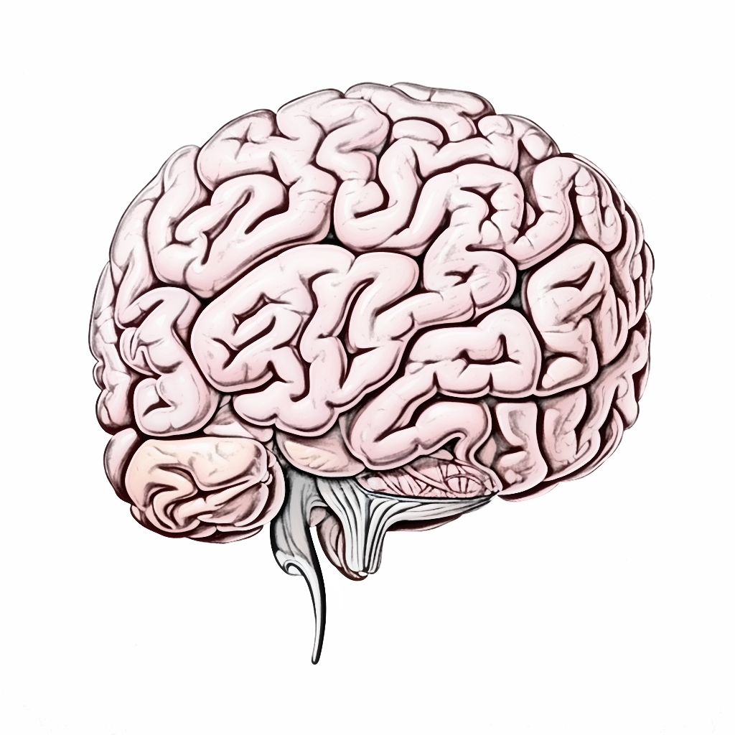
Transfer Learning (For Large Language Models this time)
Fill

Slide 27
What is transfer learning
Reuse a model trained on one task as the starting point for a model on a second task
Allows the second model to benefit from the knowledge learned by the first model
Can lead to faster training times and improved performance on the second task

Slide 28
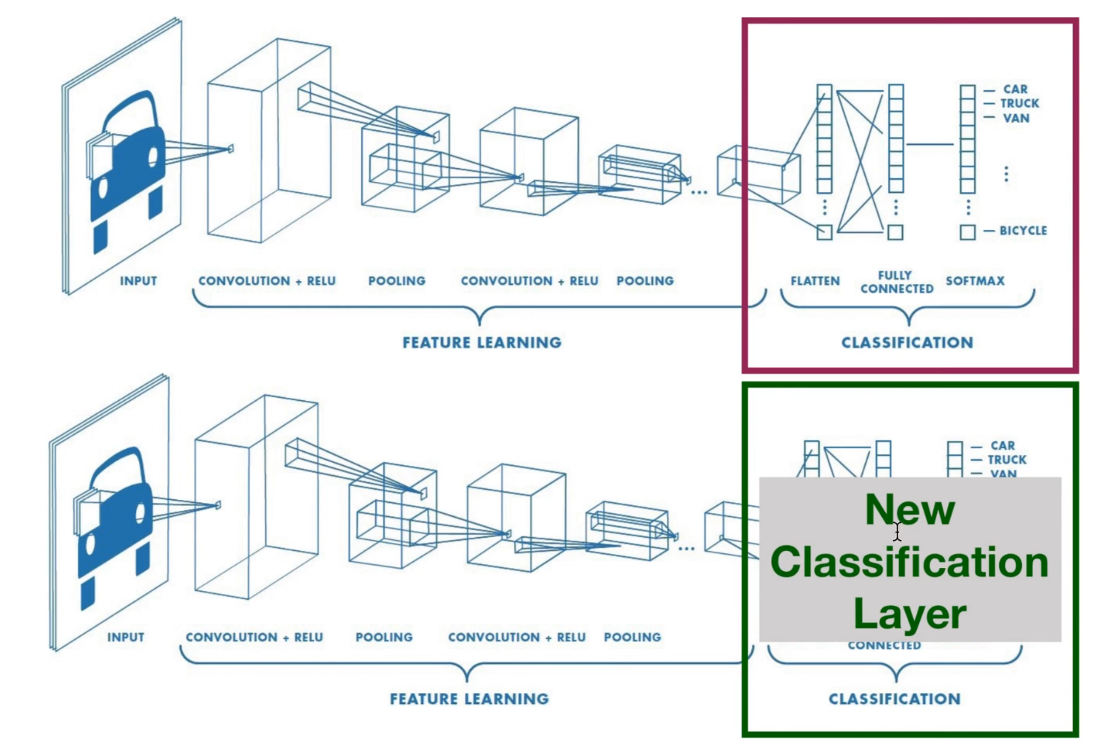


Notes:
We don’t really need a new classification layer here, unless maybe we want to change the vocabulary size but that’s not usually what we do we want to « fine-tune » a Large Language Model.
We just want to change the weights so that it learns new things, or learn how to answer in a certain way.

Slide 29
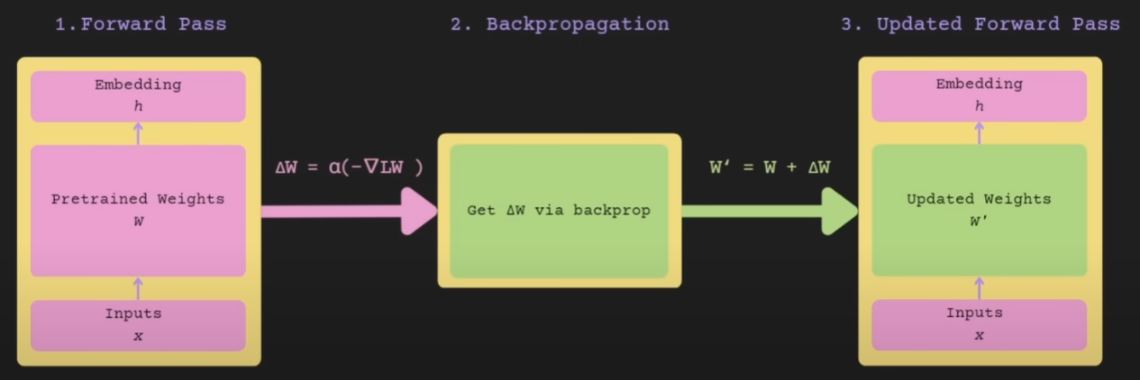


LoRA
LoRA: Low-Rank Adaptation of Large Language Models
Hu, Edward J., et al. "Lora: Low-rank adaptation of large language models." arXiv preprint arXiv:2106.09685 (2021).
Image by Chris Alexiuk

Slide 30
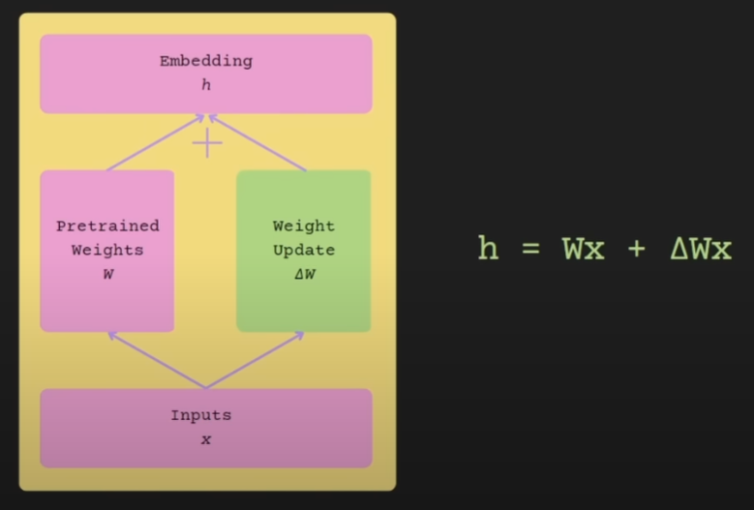
LoRA
Image by Chris Alexiuk

Slide 31















LoRA
In linear algebra, the rank of a matrix A is the dimension of the vector space generated (or spanned) by its columns.
…
Image by Chris Alexiuk

Slide 32
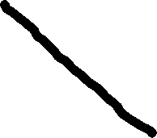




LoRA
In linear algebra, the rank of a matrix A is the dimension of the vector space generated (or spanned) by its columns.
…
Image by Chris Alexiuk

Slide 33
LoRA
Image by Chris Alexiuk

Slide 34
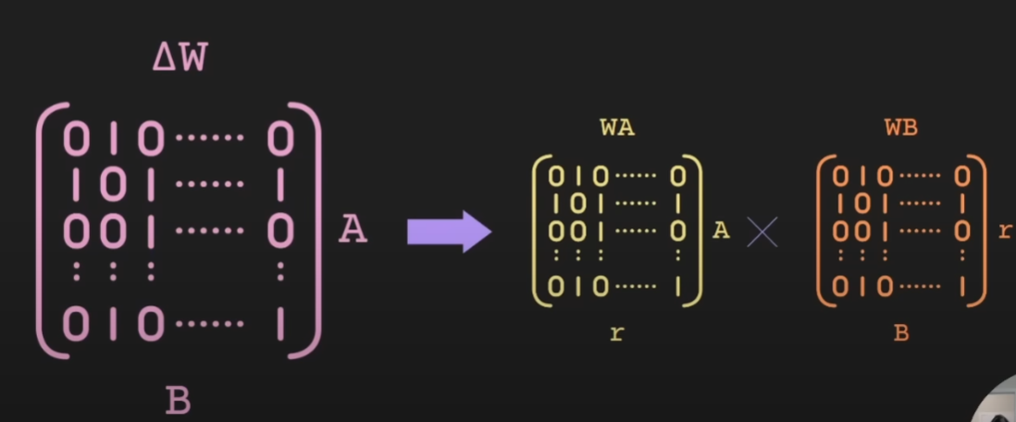
LoRA
Image by Chris Alexiuk

Slide 35
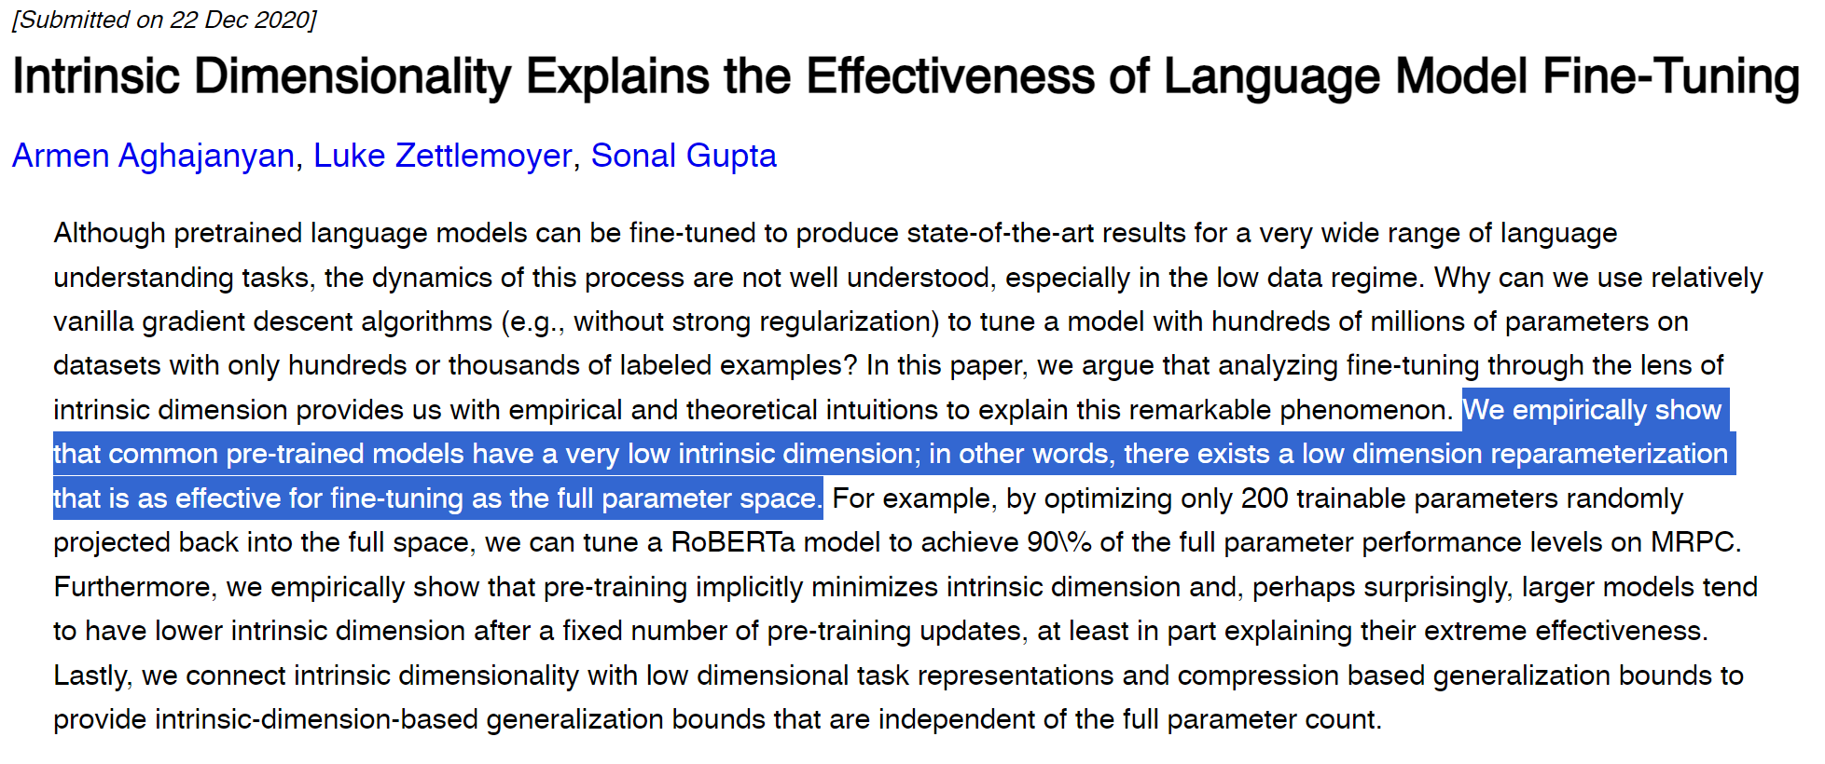
LoRA

Slide 36
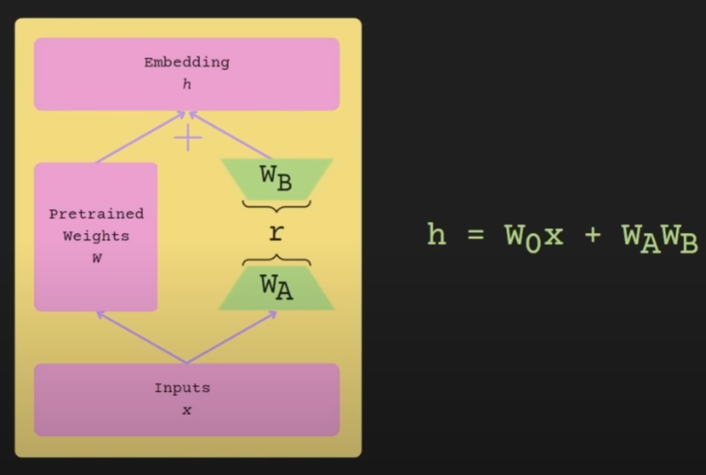
LoRA
Image by Chris Alexiuk

Slide 37
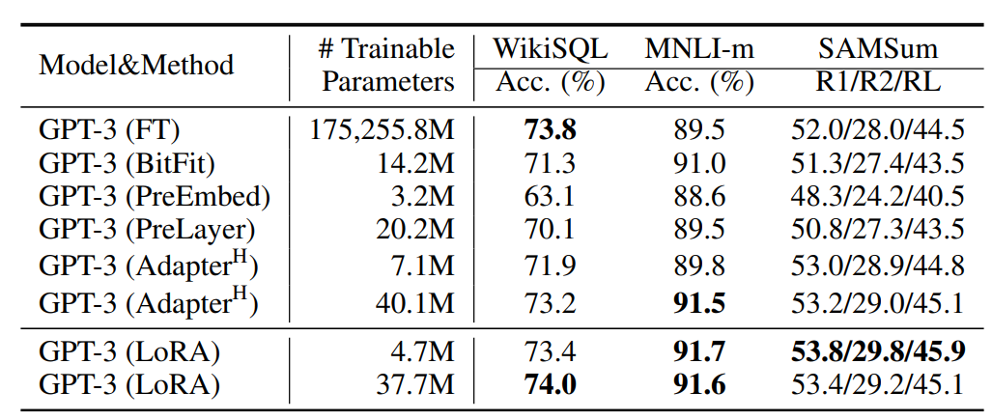
LoRA
Image by Chris Alexiuk

Slide 38
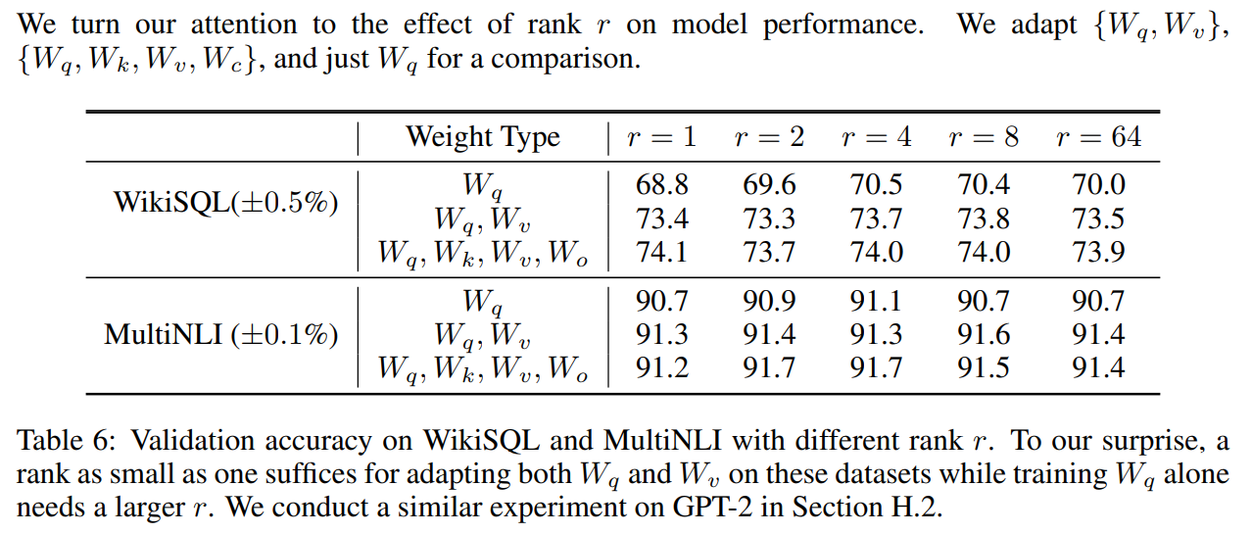
LoRA
Image by Chris Alexiuk

Slide 39
Let’s try to fine-tune LLMs with LoRA

